Slide 1
WEB SOCKETING
Abhishek J M ISE Jnnce karunadu4@gmail.com

Slide 2
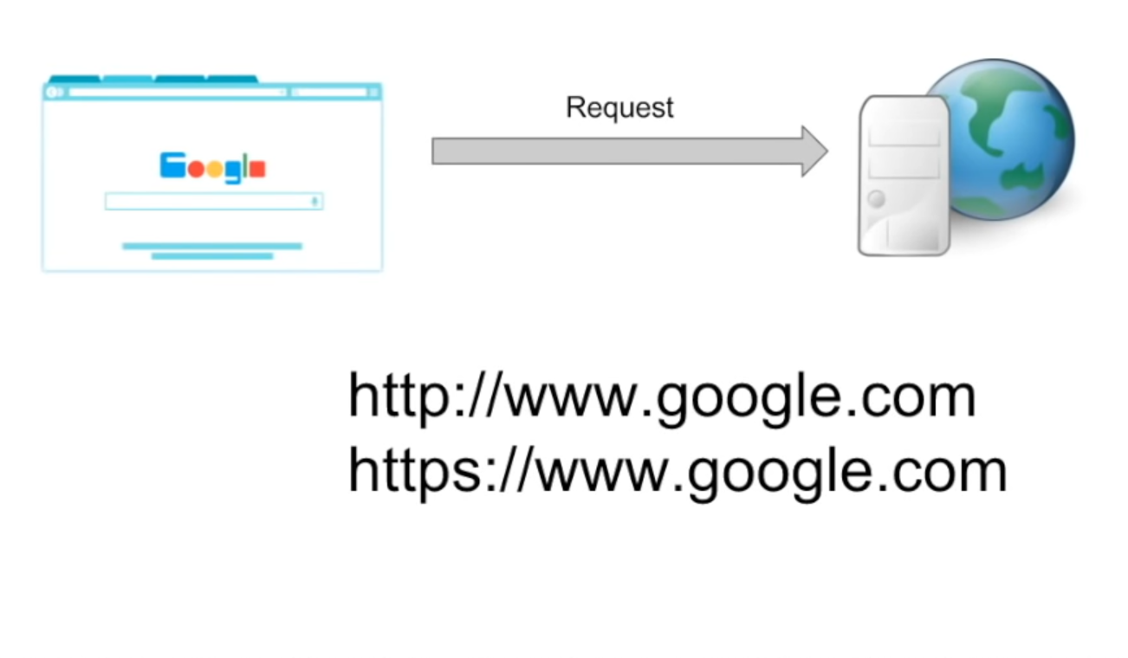
HOW DOES HTTP PROTOCOL WORKS?
Considering a typical google.com. When we hit a google.com, request goes to backend servers. The request goes in the form of http or https. Which they are the communication protocols that the browser uses to interact with the browser.
TCP Connection will setup between Client & Server. And the number of requests = number of TCP connections.
After a Particular request the server responds to the request. After the response the connection gets disconnected. We have to refresh the UI to setup new connection. Which can be defined in one word as it is Stateless.
Hence the communication mode is unidirectional.

Slide 3
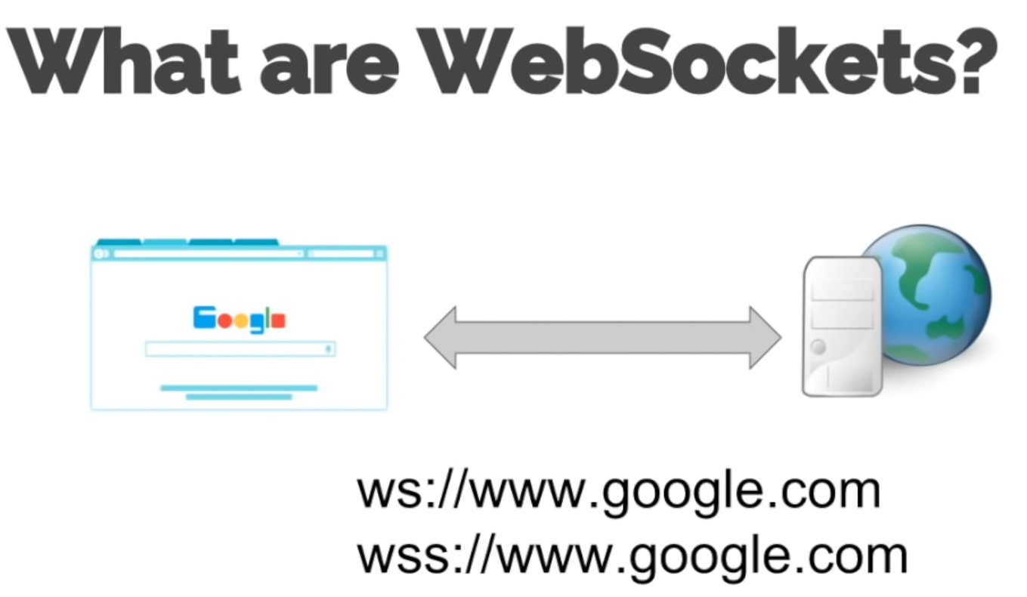
EXPLAINATION
Vice Versa of HTTP & HTTPS mode of communication.
Bi-Directional between web sockets.
Both Client & Servers will interact coherently.
Example : Chatting Application. Once the connection get’s setup, there will be Bi-Directional communication between the client & the server till both decides to terminate the connection.
One TCP connection is enough to setup the connection.
Which can be defined in one word as it is State full.

Slide 4
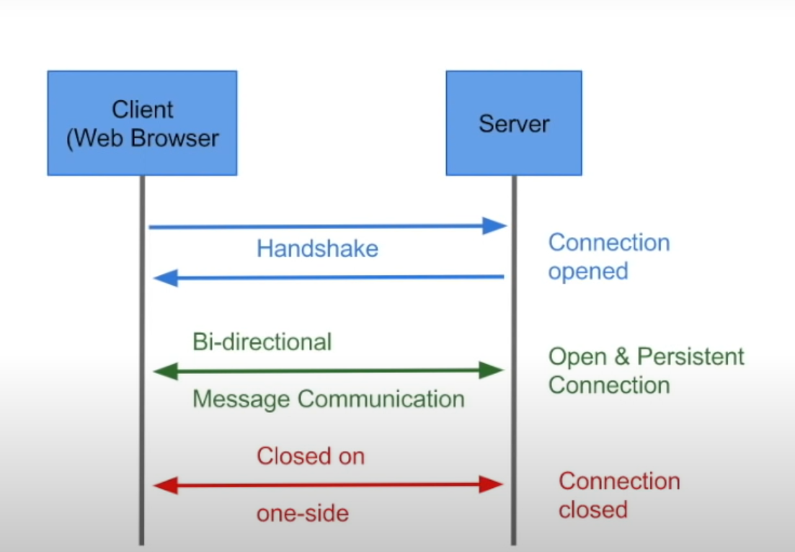
IMPLEMENTATION
Gaming Applications.
Chat Applications.
Live Feed.
Showing Client progress/logging [Upload]
Real Time Applications. If Real time updates are not needed, then Web Sockets are no of use.

Slide 5
Pros & Cons
Pros
Cons
Full Duplex (no polling) Updates.
HTTP compatible. Because first we send a HTTP request & upgrade it to websocket.
Freindly
Timeouts. We shouldn’t terminate the connection.

Slide 6
Do we have to use Web Sockets?
If we need Bi-Directional Communication.
Event Source is the push notification.
Long Polling – The server can only send the information if its has the information. For that client has to wait & server will not know that client is still in the connection. For that we use the concept called long polling.

